Slide 1
My Secret Weapon for Finding the Best Trades

Slide 2
No Bullshit Guarantee I can not and will not make you any guarantee whatsoever there is no such thing as a guarantee in the financial markets. My Results are not Typical. Also, I do not verify testimonials that people send me via email so you should Consider their performance and results as not typical. Most People Lose Money Trading and Investing.

Slide 3
Warning
IMPORTANT NOTICE! No representation is being made that the use of this strategy or any system or trading methodology will generate profits. Past performance is not necessarily indicative of future results. There is substantial risk of loss associated with trading securities and options on equities. Only risk capital should be used to trade. Trading securities is not suitable for everyone. Disclaimer: Futures, Options, and Currency trading all have large potential rewards, but they also have large potential risk. You must be aware of the risks and be willing to accept them in order to invest in these markets. Don’t trade with money you can’t afford to lose. This website is neither a solicitation nor an offer to Buy/Sell futures, options, or currencies. No representation is being made that any account will or is likely to achieve profits or losses similar to those discussed on this web site. The past performance of any trading system or methodology is not necessarily indicative of future results. CFTC RULE 4.41 – HYPOTHETICAL OR SIMULATED PERFORMANCE RESULTS HAVE CERTAIN LIMITATIONS. UNLIKE AN ACTUAL PERFORMANCE RECORD, SIMULATED RESULTS DO NOT REPRESENT ACTUAL TRADING. ALSO, SINCE THE TRADES HAVE NOT BEEN EXECUTED, THE RESULTS MAY HAVE UNDER-OR-OVER COMPENSATED FOR THE IMPACT, IF ANY, OF CERTAIN MARKET FACTORS, SUCH AS LACK OF LIQUIDITY. SIMULATED TRADING PROGRAMS IN GENERAL ARE ALSO SUBJECT TO THE FACT THAT THEY ARE DESIGNED WITH THE BENEFIT OF HINDSIGHT. NO REPRESENTATION IS BEING MADE THAT ANY ACCOUNT WILL OR IS LIKELY TO ACHIEVE PROFIT OR LOSSES SIMILAR TO THOSE SHOWN.

Slide 4
Hubert Senters
NO B.S. Approach to Trading & Investing

Slide 5
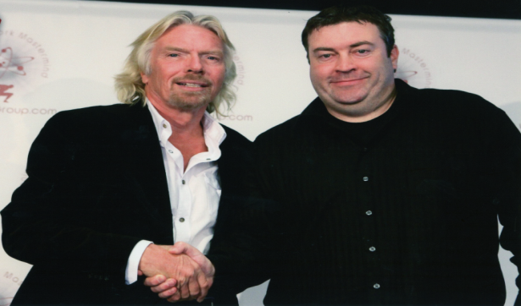
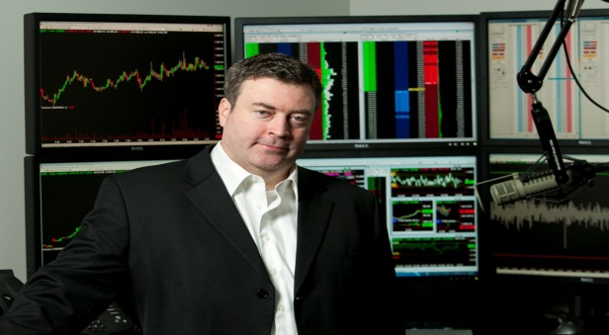
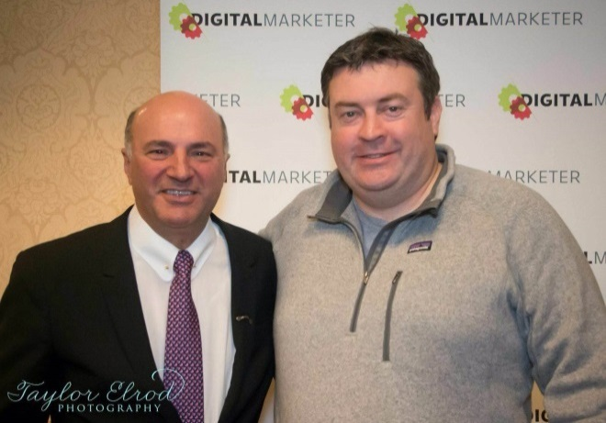
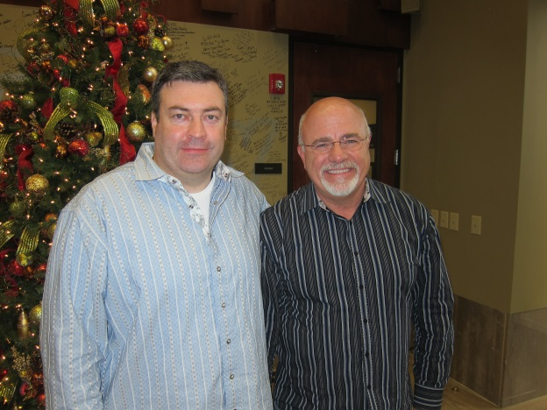
What I believe
Notes:
Add picture of dave here

Slide 6
Congratulations
You are in the Right Place at the Right Time Here’s Why…

Slide 7
I believe if you learn how to use this tool properly
It can shave years off your learning curve.
On Mastering the skill and art of reading a chart

Slide 8
To Hubert & Your Team, THANK YOU !
I have been on this trading game for about a year and a half.
Several disappointments until I bought your cloud course on.
You and your staff made me smile with the photo of the sign Welcome Mack and all of you in it !
You guys have answered every question I have had quickly and accurately. I try to watch all of your daily videos.
A few weeks ago, it hit me to use them to get in fresh trades. I am using TD Ameritrade TOS. A few weeks ago, I started using the Paper Money side of TOS, and at this writing I am $5,354.oo Up using "The Cloud" & your suggestions.
I am VERY conservative and using mostly under $100.oo stocks. Never more than 100 units and a lot of 10 and some 1s.
Yesterday I started slowly with real money and this morning I did take a small profit but still watching that one.
Please keep up the good work ! Thank You All !!!!
Mack and I quote... Good Luck, I hope it Helps !

Slide 9
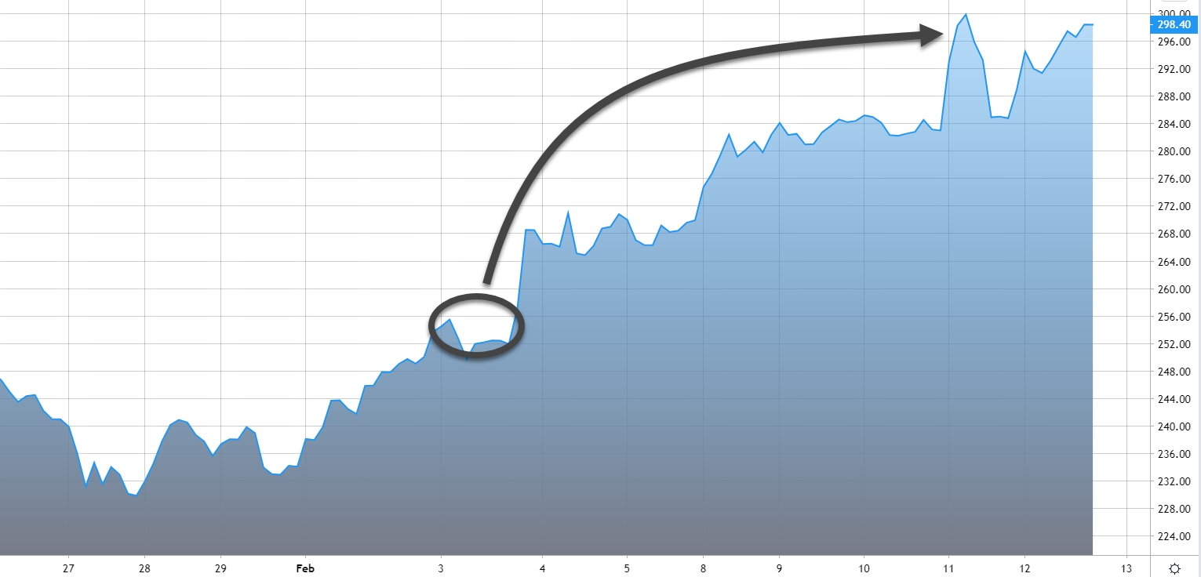
PYPL

Slide 10
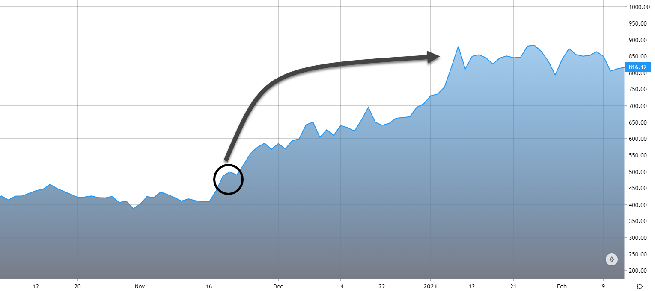
TSLA

Slide 11
Your seminars and "Tech Tuesdays" have been quite valuable.
I have learned to be a disciplined trader.
I am sticking to my rules. This has made all the difference in the world.
It is the one thing that in the past I was unable or unwilling to do. I now have some strict "if then" statements before I enter a trade.
Also, for the first time ever, I am consistently setting stop losses when I place any trade.
I am up over $10,000 in about 45 days. This includes some losses which I take from time to time. You are correct that "letting profits run" is the place to be, but one must have some rule-based criteria. I do cut losses quickly while choosing to give some stocks room to move.
The Ichimoku system is the very best. Again, I stick to the rules. Thank you for all your help As a result of your training, I no longer use the following words in trading:
1) I hope 2) I think 3) It will probably come back 4) I wish 5) I predict that…..I hope you will share this e-mail to others. I only focus on what is happening NOW and then look at my rule-based criteria for buying or going short.
Ron

Slide 12
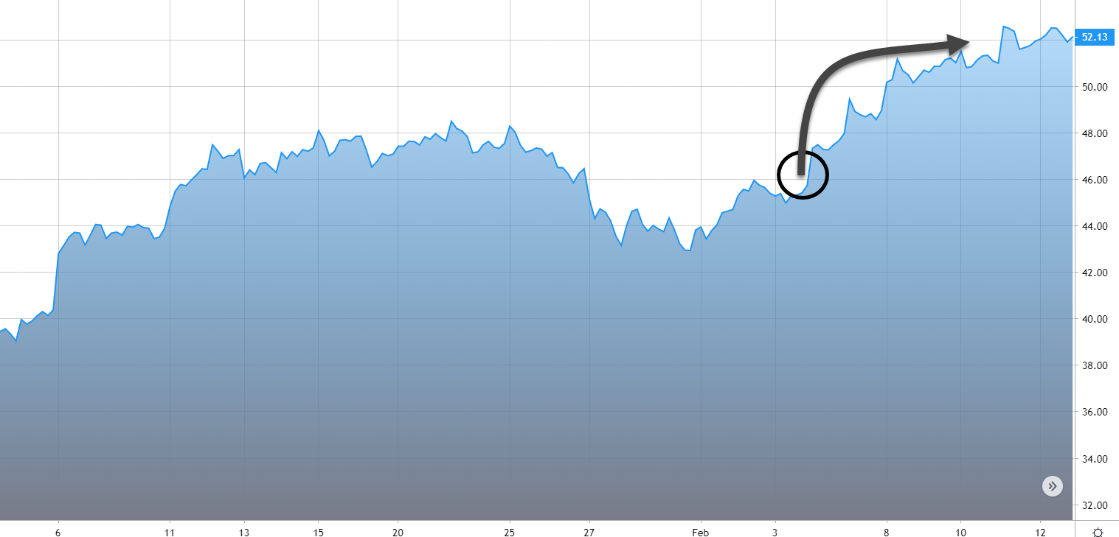
FL

Slide 13
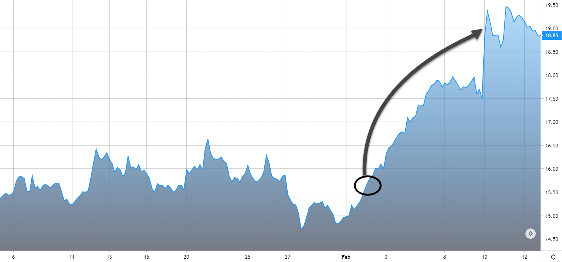
UA

Slide 14
I particularly enjoyed the last Technical Tuesday evening session format where Hubert allowed attendees to submit symbols to him which he then charted and offered his opinion on.
I made over $9600 the following couple of days trading symbols that I would otherwise have never know about.
Please dedicate 10 minutes or so every Tuesday to this activity. It makes your subscription fee look really cheap. Thanks, Bill

Slide 15
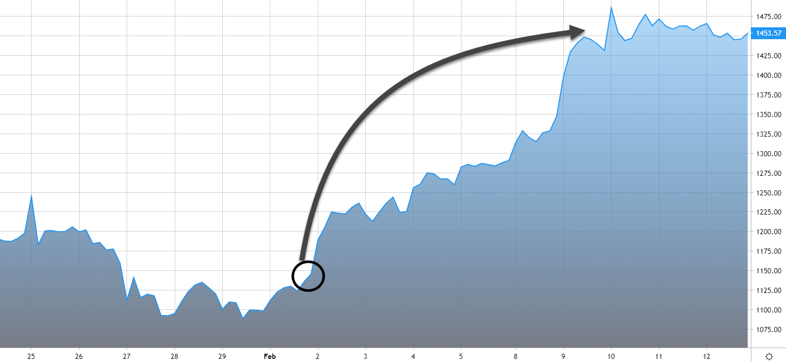
SHOP

Slide 16
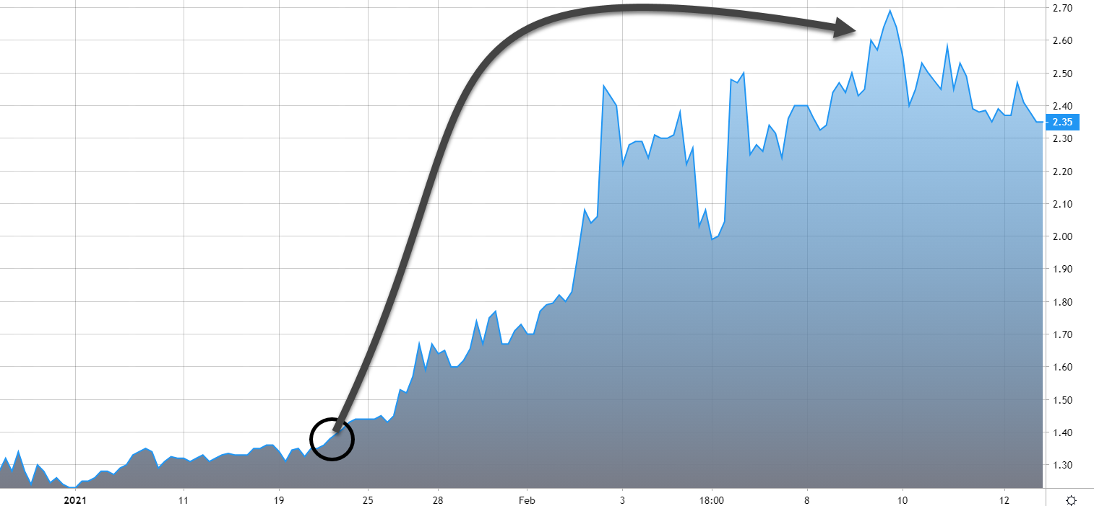
CTHR

Slide 17
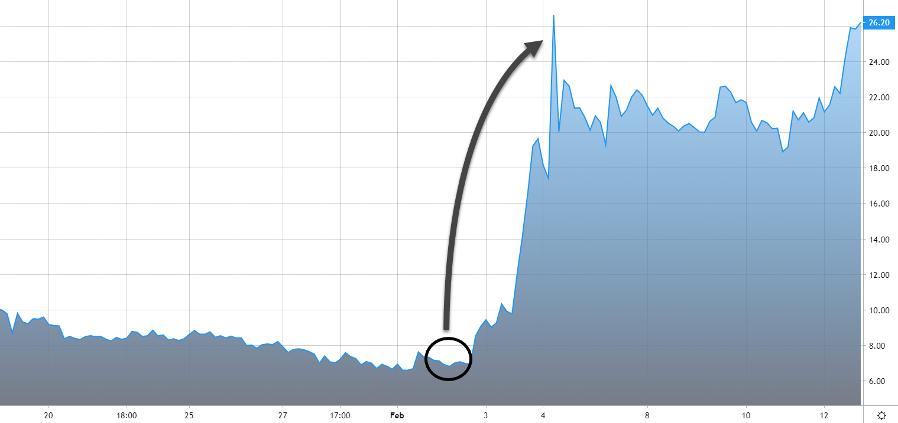
CPSH

Slide 18
Trades you could have Taken
CF = $6,350
DOW = $39,150
Bonds = $24,156
$69656
Notes:
Now you might not of captured all these but even if you had just captured 1 of these trades imagine what that would do for your trading business?
Let me ask you this if you generated an extra (whatever the total is for those 3 trades ($10,024) in a month what would you do with that money?
Would you take that vacation you have always wanted to go on?
Would you finally pull the trigger on purchasing that new car?
What if all this did was give you the piece of mind of knowing you are going to be able to retire with more than enough.
And if you are sitting thinking to yourself this isn’t possible for me, then let me share with you some students that are just like you that have had great success using this same very tool.

Slide 19
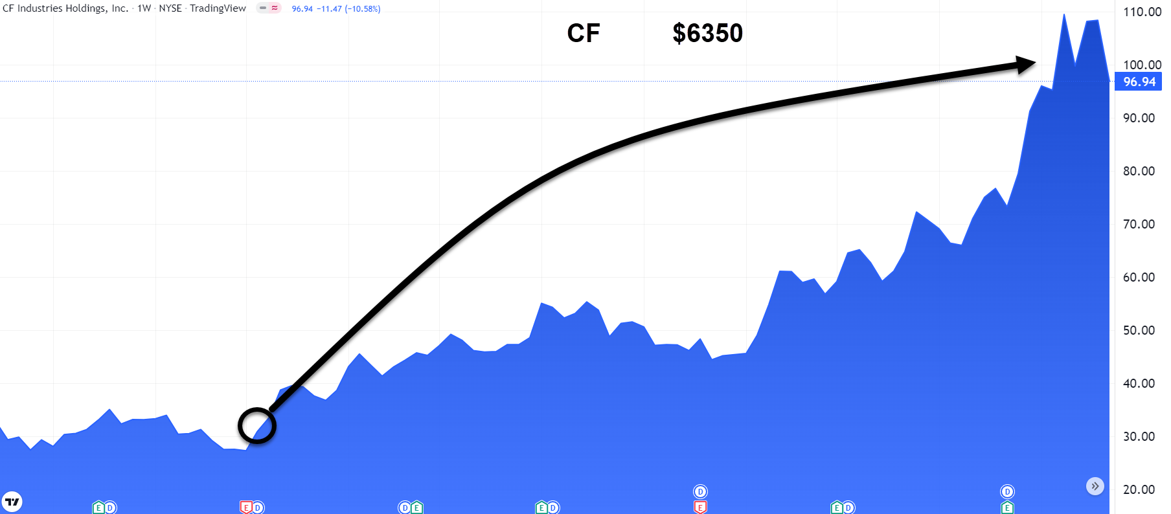

Slide 20
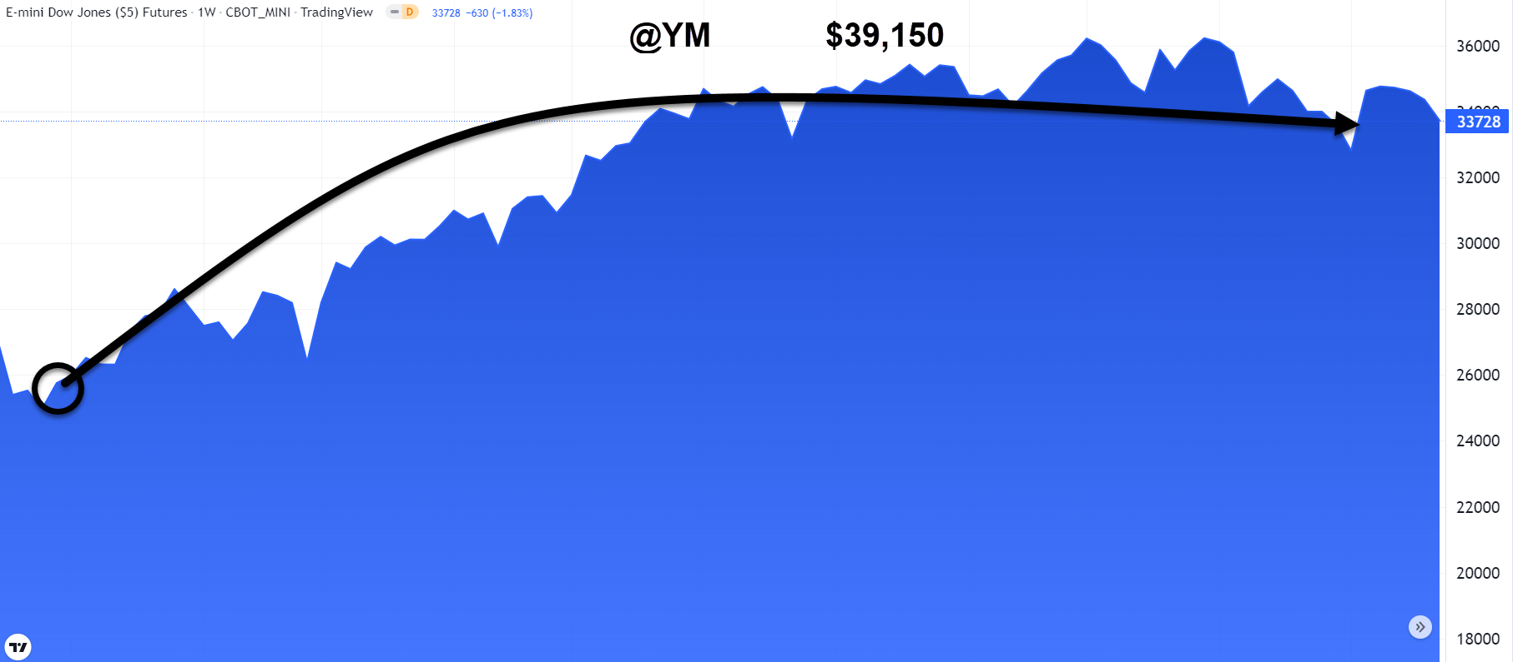

Slide 21
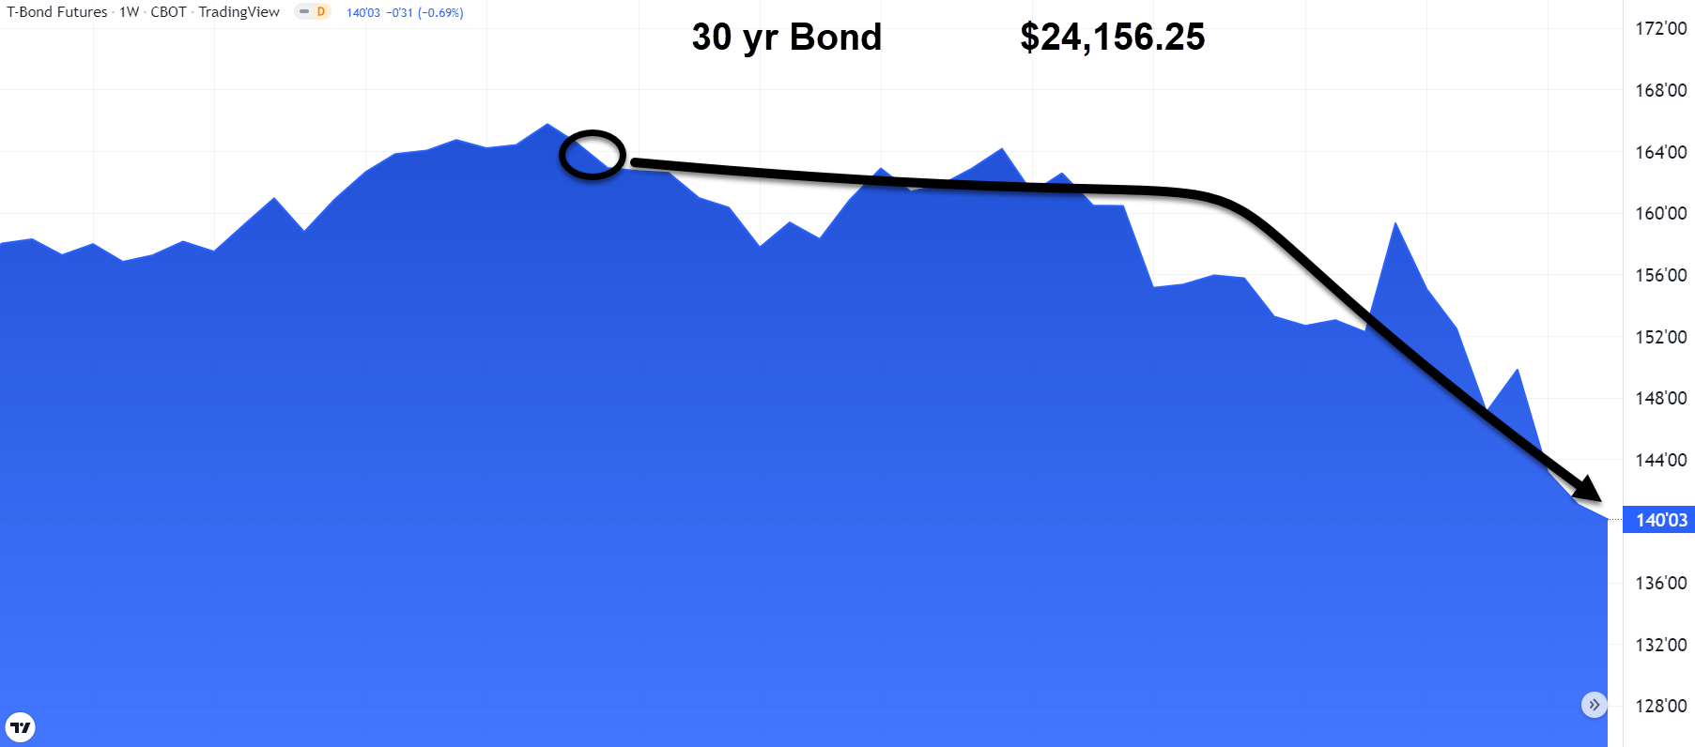

Slide 22
What does This Work on?
Stocks
Options
Futures
Forex
Bonds
Gold
Commodities
Cryptos

Slide 23
What Time Frame?
Day Trading
Swing Trading
Investing

Slide 24
This will be… DIFFERENT (in a good way)

Slide 25
S&P 500 Results (last 5 years)
Stocks in the index 430/500 86%
33% return if you take ever signal
79% if you remove the counter trend signals and wait for 3 day confirmation
Across all stocks in the S&P 500

Slide 26
Profitable on 29 currencies Over last 10 years
Daily- Hourly- 10 min

Slide 27
Time Frame selection
 | Scalp | Very Short | Short Term | Medium Term | Swing Trade | Core Trade | Investor Pray
Time Horizon | Minutes | Hours | Days | Weeks | Months | Years | Many Years
Chart Time Frame | Ticks 1 Min | 5/10 Mins | Hourly | Daily | Weekly | Monthly | 3 Months
Cloud Extends | 30 Mins | 2-4 hours | 3 days | 1 Month | 6 Months | 2 Years | 8 years

Slide 28
This is what you want
#1 Technique used in Japan
Know exactly what’s happening in seconds
Trends and Signals
Designed to produce clear signals

Slide 29
Edge For You Now
Past
Present
Future

Slide 30
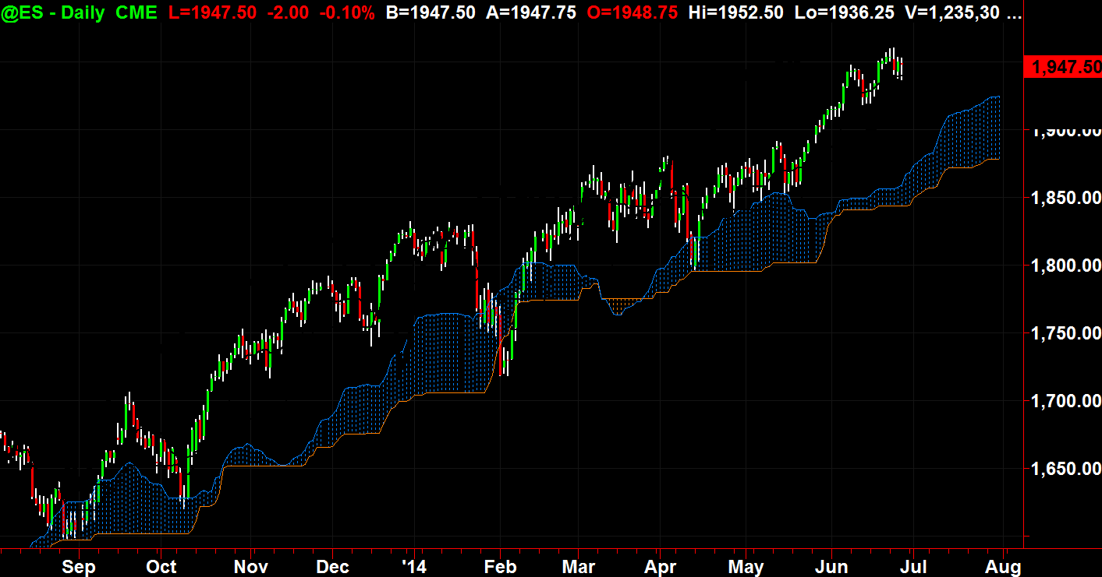

Slide 31
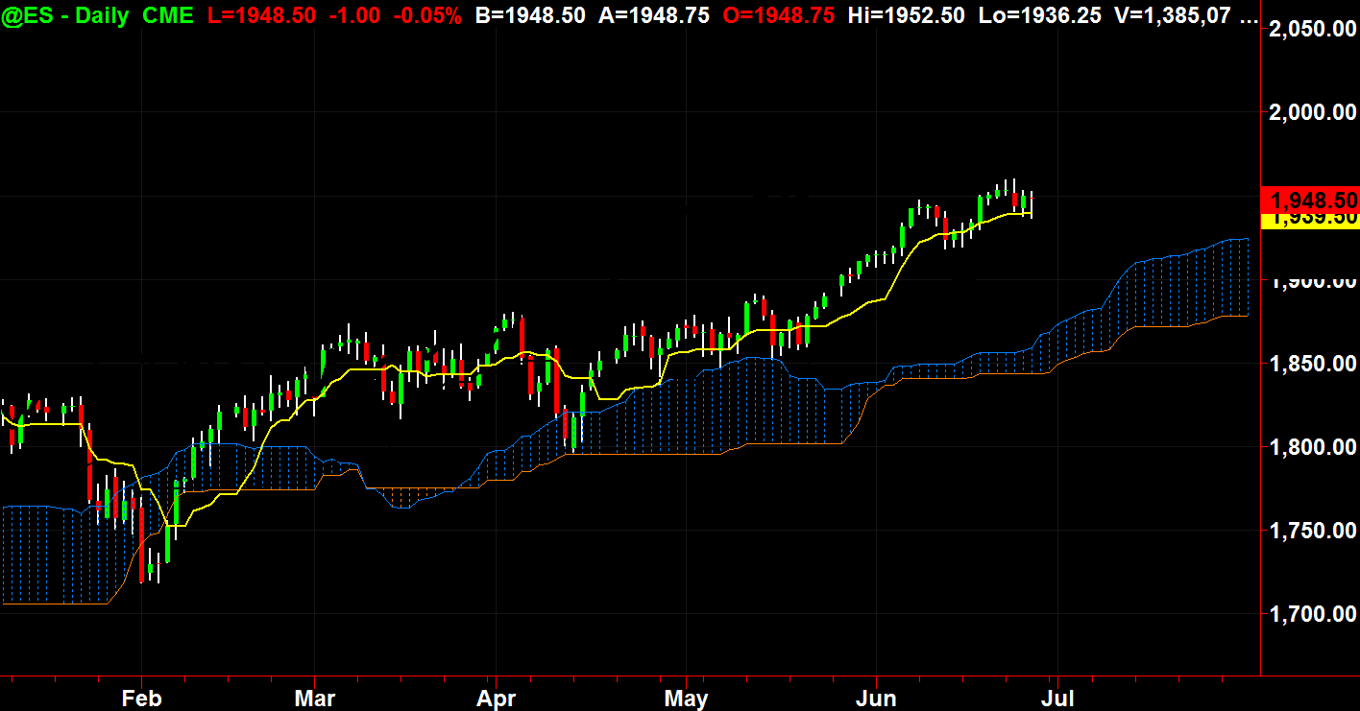

Slide 32
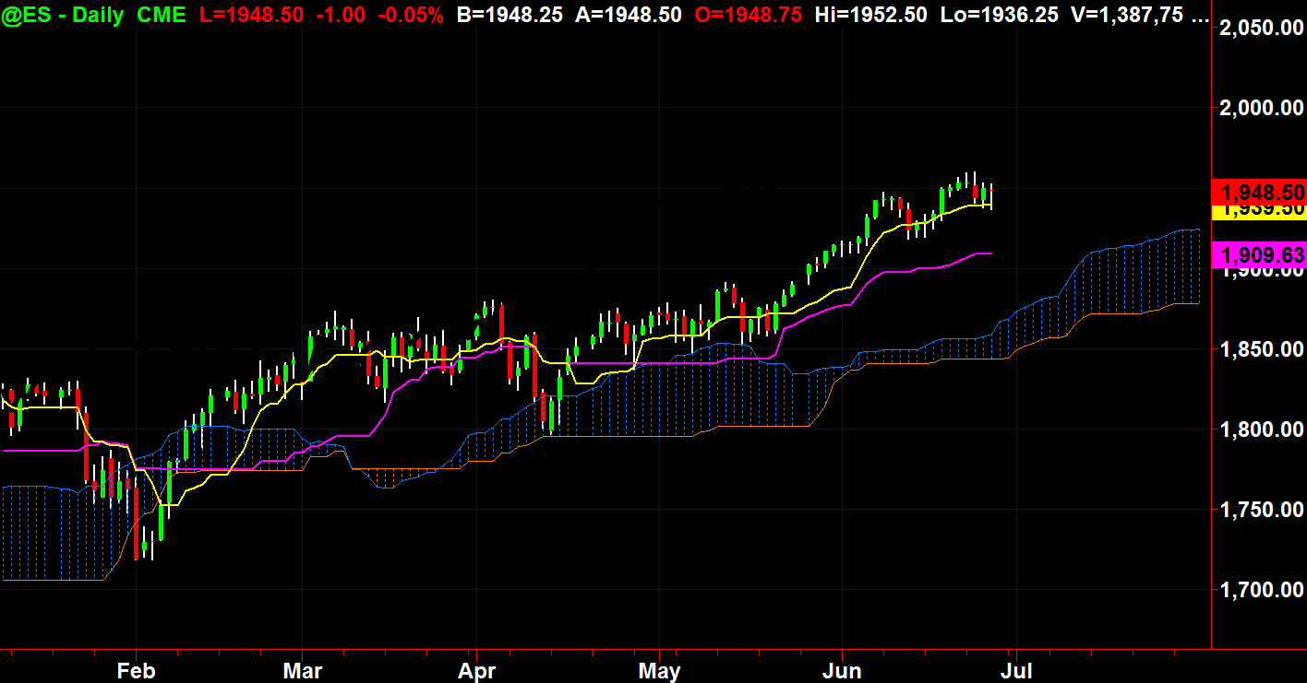

Slide 33
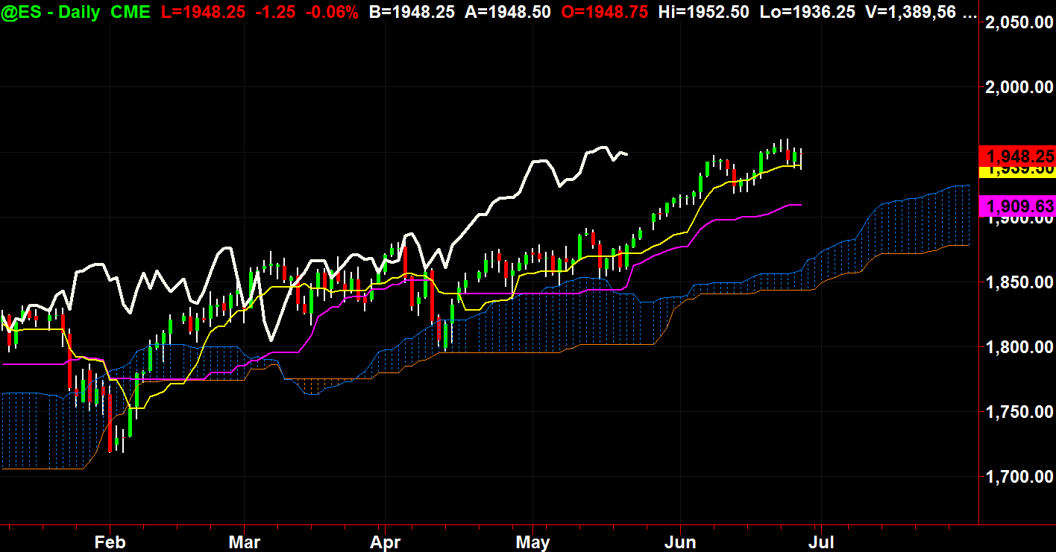

Slide 34
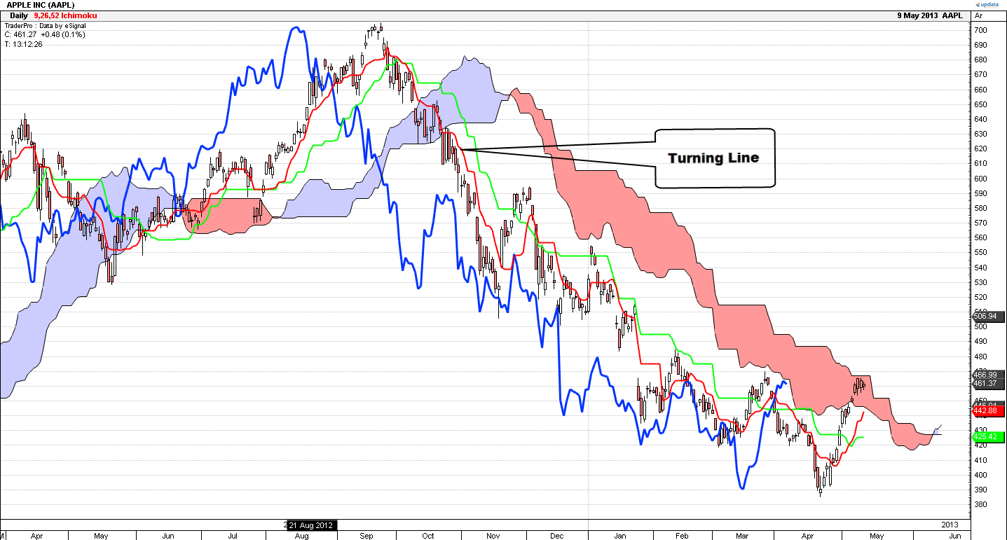
Turning Line: Midpoint calculations
Take the high and the low of the last
9 days and divide them by 2

Slide 35
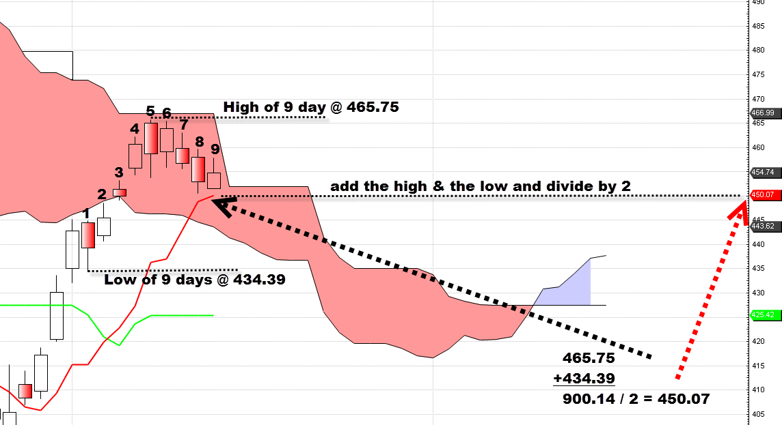

Slide 36
Standard Line
Midpoint of the high and the low of the last 26 sessions
Take the high and the low of the last 26 bars.
Then divide by 2
That number is the midpoint

Slide 38
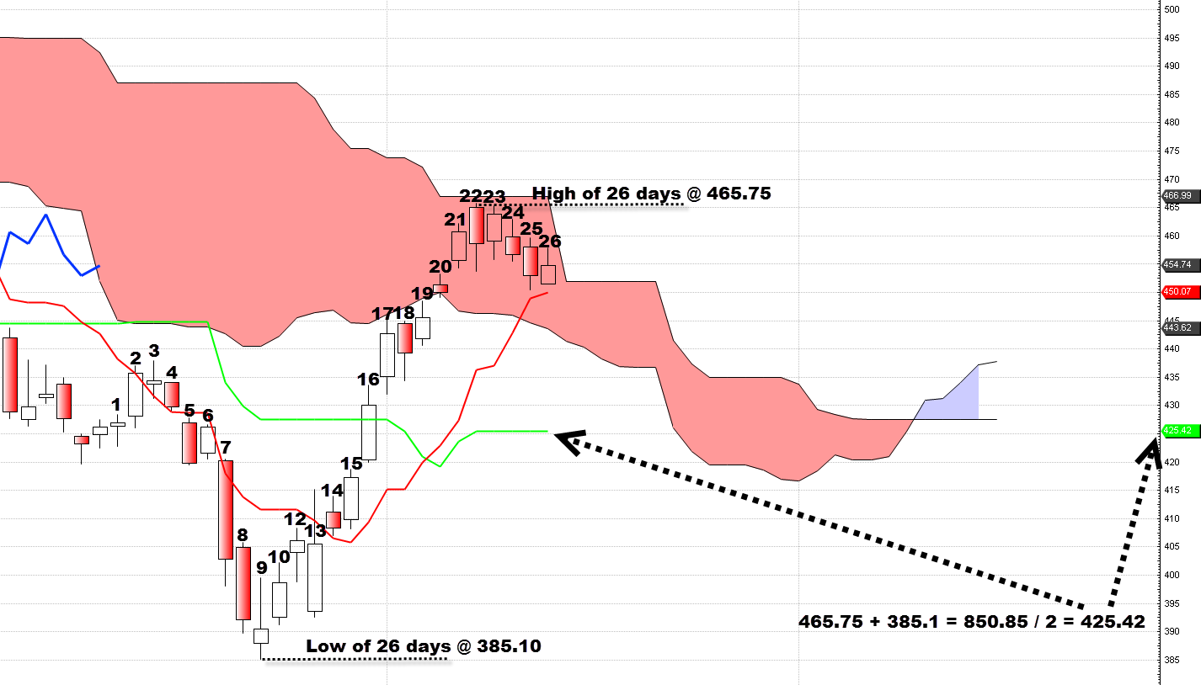

Slide 39
Cloud Span A
Midpoint of turning line and standard line shifted 26 bars forward

Slide 40
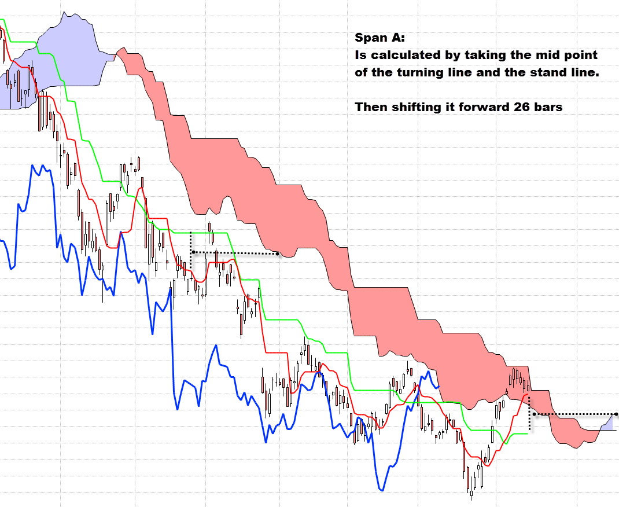

Slide 41
Cloud Span B
Midpoint of high and low of the last 52 sessions shifted

Slide 42
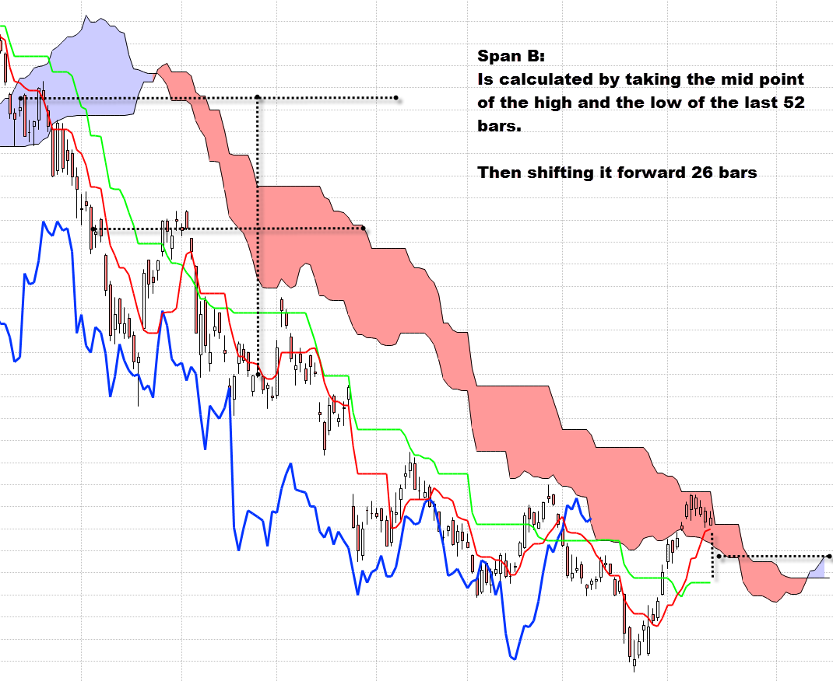

Slide 43
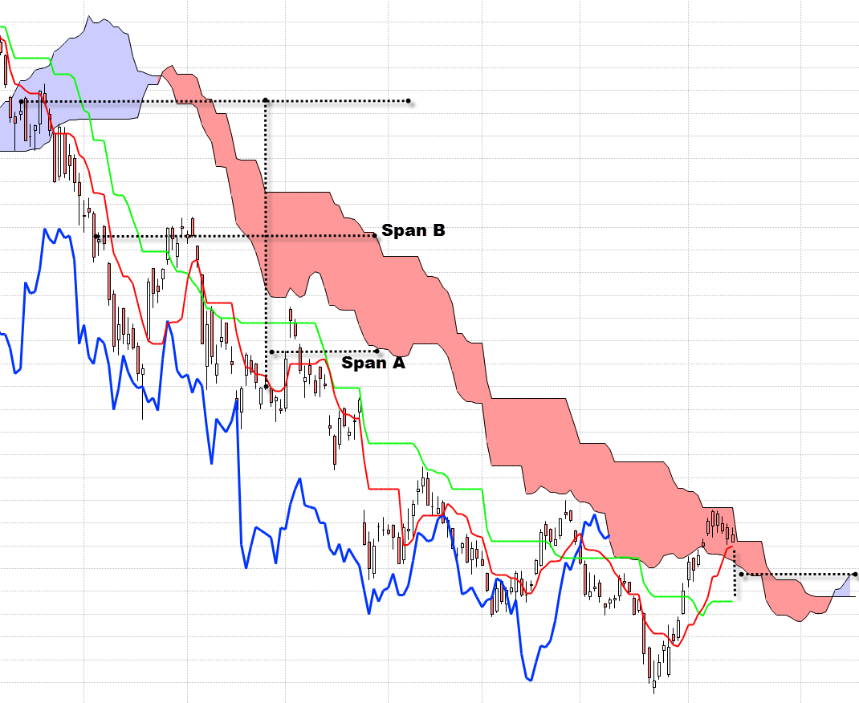

Slide 44
Lagging Line
The Lagging Line – the price line (close) shifted back 26 bars

Slide 45
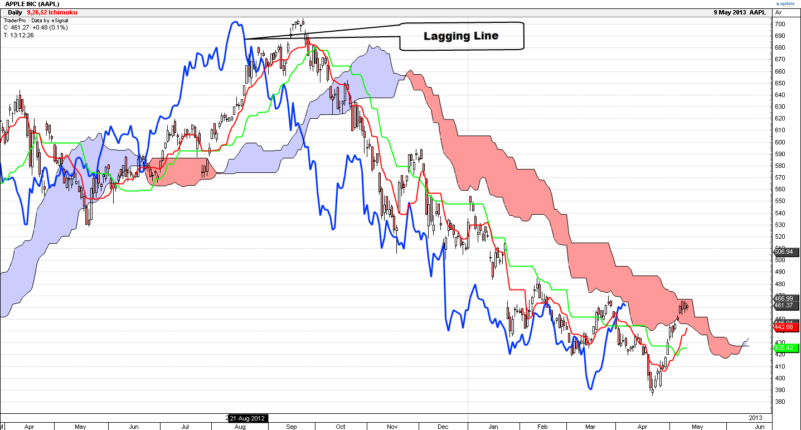

Slide 46
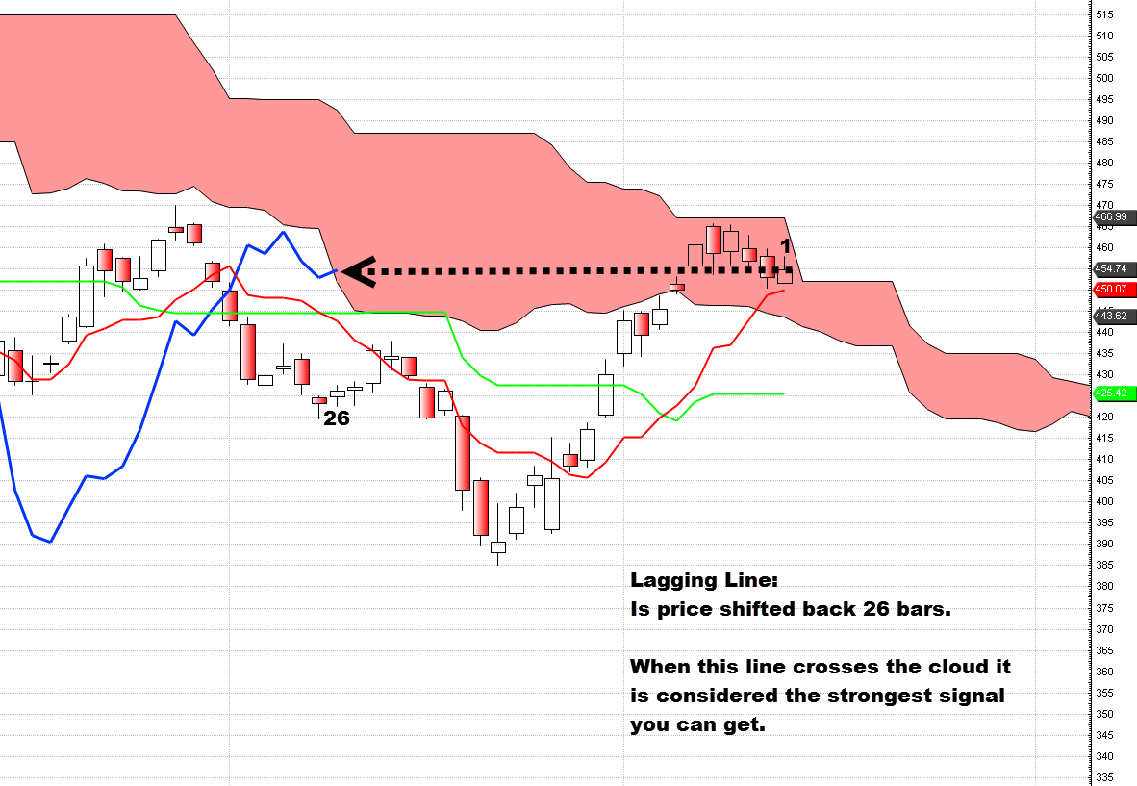

Slide 47
Ichimoku Cloud Chart Signals
Lagging line crossing the cloud
Price crossing the cloud
Price and lagging line touch the cloud
The cloud spans crossing
The turning line crossing the standard line

Slide 48
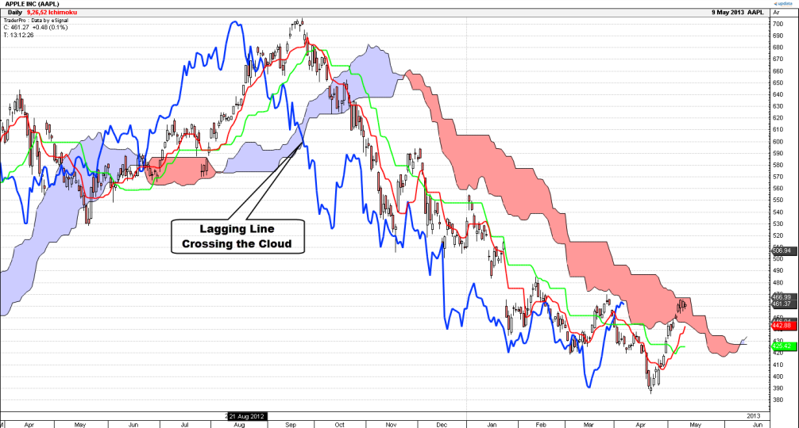

Slide 49
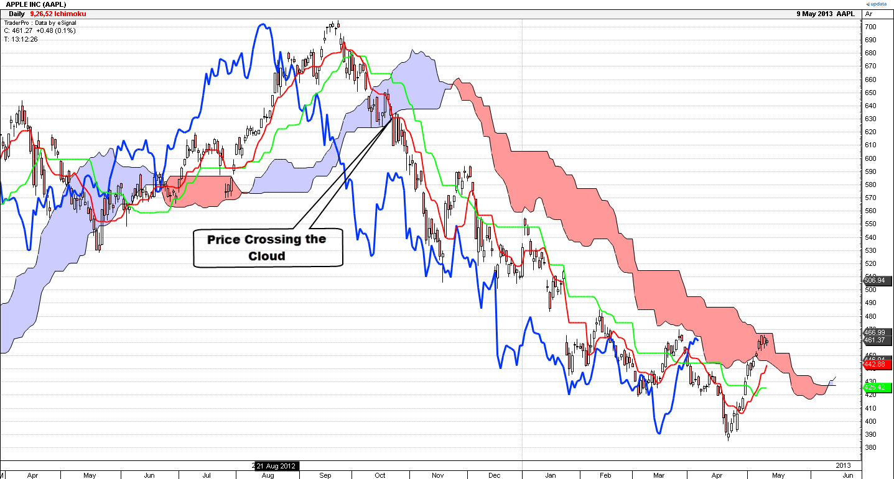

Slide 50
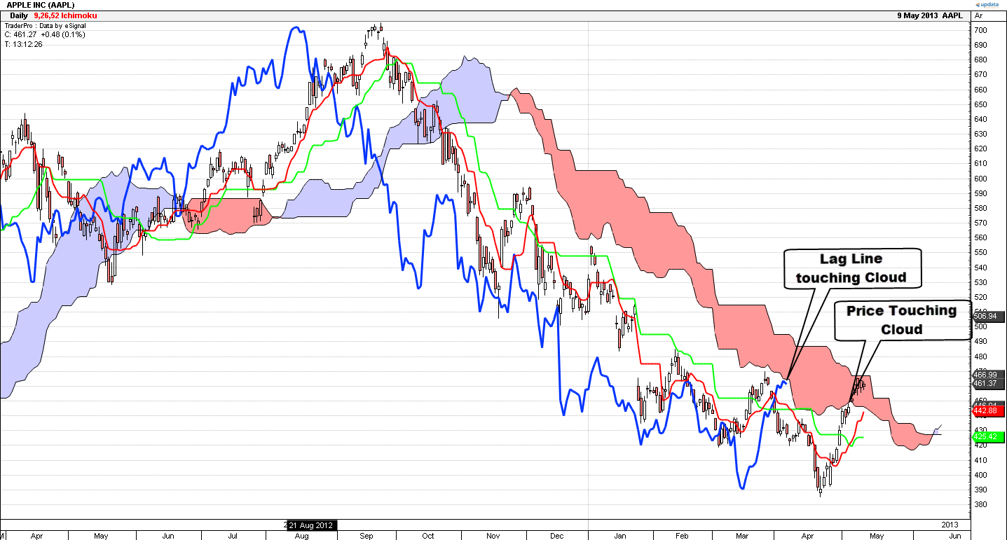

Slide 52
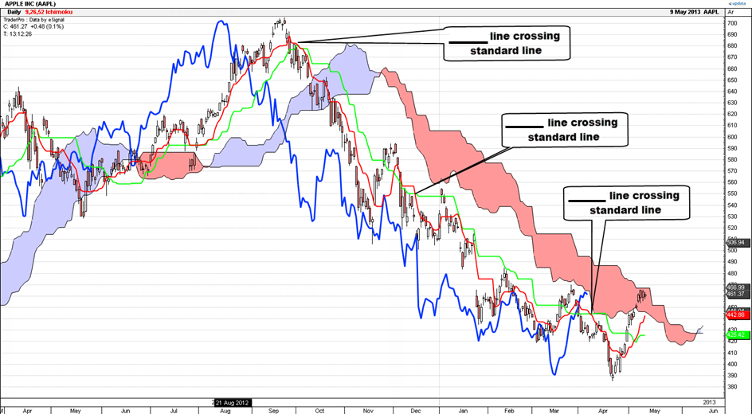

Slide 53
Bullish Signals
Price above the cloud bullish.
Prices in the cloud are bullish if they came from bullish side.
The lagging line crossing the cloud is the main signal of trend change.
Price crossing the cloud is an earlier but less reliable warning of trend change.
Price and the lagging line will often find support at the cloud edges.
Cloud span crossing may be a sign that the trend is changing.
Be on the lookout for thick clouds after a run, which could mean imminent trend change.

Slide 54
Bearish Signals
Price below the cloud bearish.
Prices in the cloud are bearish if they came from bearish side.
The lagging line crossing the cloud is the main signal of trend change.
Price crossing the cloud is an earlier but less reliable warning of trend change.
Price and the lagging line will often find resistance at the cloud edges.
Cloud span crossing may be a sign that the trend is changing.
Be on the lookout for thick clouds after a run, which could mean imminent trend change.

Slide 55
Time Frame selection
 | Scalp | Very Short | Short Term | Medium Term | Swing Trade | Core Trade | Investor Pray
Time Horizon | Minutes | Hours | Days | Weeks | Months | Years | Many Years
Chart Time Frame | Ticks 1 Min | 5/10 Mins | Hourly | Daily | Weekly | Monthly | 3 Months
Cloud Extends | 30 Mins | 2-4 hours | 3 days | 1 Month | 6 Months | 2 Years | 8 years

Slide 56
Multi-Time-Frame Analysis
Monthly
Weekly
Daily (My Favorite)
Hourly (My Favorite)
10 min (My Favorite)
1 min

